Slide 1


SGHS
Senior Core
Curriculum
CLASS OF 2025
Unlock Your Future with Core Curriculum!

Slide 2


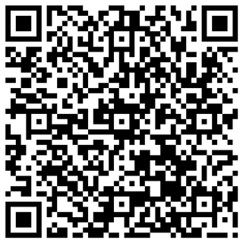

Today’s Agenda
01.
02.
03.
COMENTS
SCAN THIS!
MEET YOU COUNSELORS!
NEXT STEPS
Pre-Assessment
1-on-1 meetings are scheduled student appointments!
2- Year, 4- Year College/ University, Technical College/ Trade School, Military Enlistment, and/ or Employment

Slide 3




COMENTS
COUNSELORS
We are your supportive community!
MS. CUNNINGHAM
MRS. DEBOWLES
MRS. COTTON
MRS. PICKARD
Head Counselor
PSLM Counselor
Dual Enrollment (Last Names: M-Z)
10th-12th Grade
Last Names: A-Dom
Room: A- 119A
STEM Counselor
10th - 12th Grades
Last Names Don- Kn
Room: D13.130 (in D104)
BEH Counselor
Dual Enrollment (Last Names: A-L)
10th - 12th Grades
Last Names: Ko-Ric
Room: 10.236
HHS Counselor
10th- 12th Grades
Last Names: Rid- Z
Room: D215

Slide 4
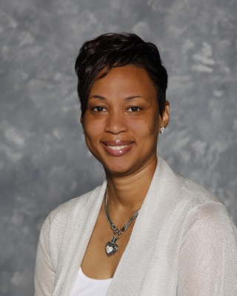



COMENTS
COUNSELORS
We are your supportive community!
“Working Together- Winning Together PreK-12 Grade”
#PROUD2BE
MR. BAKER
DR. STEPHEN
College & Career Specialist
Room: A119-B
9th Grade Counselor
Room: E-311

Slide 5

LET’S CHECK IN!
On a scale of 1-10
rank your level of anxiety
(10 being the most anxious)
CLASS OF 2025

Slide 6



SGHS
MINNESOTA
TWO YEAR
TECHNICAL COLLEGE
TUITION & FEE
Approximately $5000 per year for full-time enrollment (Gwinnett Technical College)
Degrees offered: Associates, Certificate, Diploma
Programs of Study
Provides:
Classes and degrees directly aligned with a particular career or job field.
GA Technical College System has a 98% placement rate within six months of student graduation.
ADMISSION REQUIREMENTS
•High School Diploma
• ACCUPLACER typically required
• SAT / ACT optional

Slide 7

SGHS
MINNESOTA
TWO YEAR
JUNIOR COLLEGE
TUITION & FEE
Approximately $4000 per year for full-time enrollment
(GA State University at Perimeter College)
Degrees offered: Associates
Provides:
A cost-effective option to start taking general college classes which could be applied towards a 4 year degree at a college or university
Typically have student transfer agreements with four year colleges.
ADMISSION REQUIREMENTS
•High School Diploma
•GPA may be evaluated
(2.0 GPA minimum for GPC)
•SAT / ACT or other admission test may be required

Slide 8

SGHS
FOUR YEAR
COLLEGE & UNIVERSITIES
Degrees offered: Bachelors, Masters and/or Doctoral
TUITION & FEE
•College Preparatory Curriculum
•GPA
•SAT / ACT
•Class rank
•Essay
•Extracurricular Activities
•Letters Of Recommendation
ADMISSION REQUIREMENTS
Public (In-State): Average approx. $10,000 per year
(does not include room/board)
Public (Out-of-State):
Average
$26,382/year
(does not include room/board)
Private:
Average $36,000/year
Provides:
A well-rounded college experience.
Typically have large selection of course offerings in variety of majors and programs of study

Slide 9

SGHS
TRADE SCHOOLS
TUITION & FEE
ADMISSION REQUIREMENTS
  Varies widely depending on the program and location.
  Typically ranges from $5,000 to $20,000 for a full program.
  Some programs offer financial aid, scholarships, or payment plans.
  High School Diploma
  Transcripts
  Application and Application Fee
  Placement Test
  Personal Statement and/or Portfolio
Provides:
  A hands-on learning and industry-specific certifications
  Vocational or technical training for various careers such as plumbing, electrical work, automotive repair, culinary arts, HVAC Technician, Licensed Practical Nurse (LPN), Electrician, Welding and more.
DEGREE/ CERTIFICATIONS
  Diplomas, certificates, and associate degrees in specialized fields.
  Duration: Programs typically range from 6 months to 2 years.

Slide 10

SGHS
MILITARY PATHWAYS
Armed Forces: Army, Navy, Air Force, Marine Corps, Coast Guard
Service commitments usually range from 2 to 6 years, depending on the branch and role.
Military training can translate to civilian certifications and job skills. Provides extensive training and leadership experience.
Opportunity to pursue college degrees through military education programs (e.g., Army’s Tuition Assistance, Air Force's Community College of the Air Force).
TUITION & FEE
  Generally free of charge for service members
  G.I. Bill benefits and military scholarships available for further education after service
ADMISSION REQUIREMENTS
  Recruitment Office: Visit a military recruitment office
  Application Form
  ASVAB: The Armed Services Vocational Aptitude Battery (ASVAB) is required to determine your aptitude for various military roles.
  Physical Fitness Test: Some branches may require a physical fitness test.

Slide 11

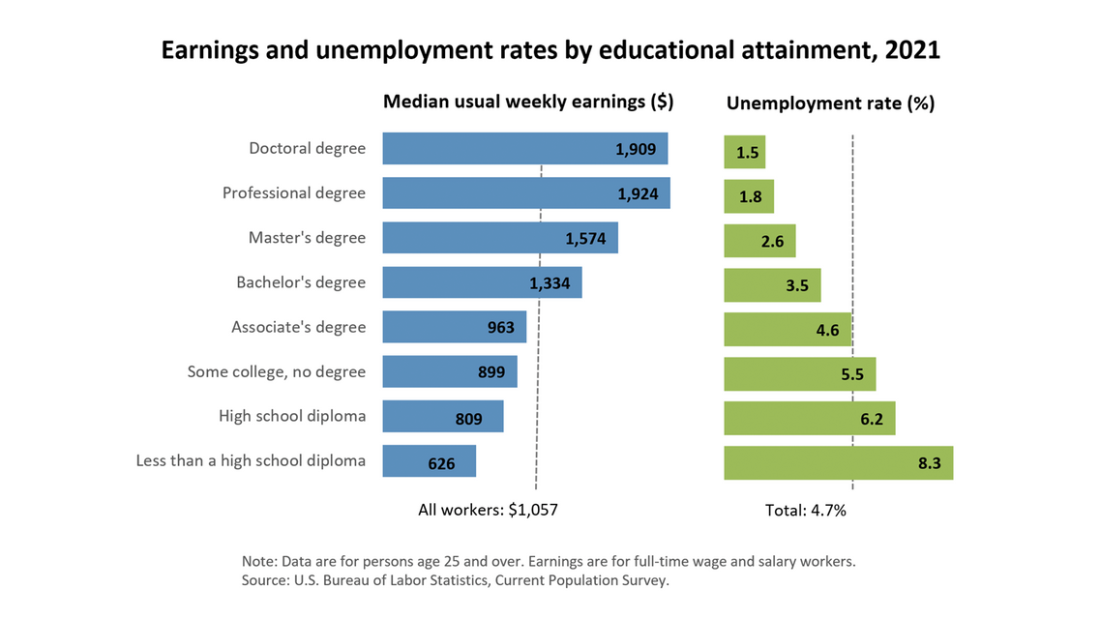

Slide 12


1.THE APPLICATION
2.REQUESTING A TRANSCRIPT
3.Letters of Recommendation
4.SAT/ACT/ACCUPLACER tests
5.Essay
6.Track Your Progress
WE ARE SOUTH!

Slide 13

DEADLINE ARE IMPORTANT!
Meeting your deadline= ALL Required Documents Have been Submitted!
EARLY DECISION
EARLY ACTION
•Not Binding
•UGA and GA Tech
•If Deferred, student can reapply
Regular Decision
REGULAR DECISION
•Binding ( Have to Commit, if Accepted)
•Emory
•Not Binding
•UGA and GA Tech
•ROLLING ADMISSIONS
•Review of application is on-going
•Kennesaw State
May deadline/notifications on-going
OPEN ADMISSIONS
•Review of application is on-going
•Deadlines and Notifications vary

Slide 14


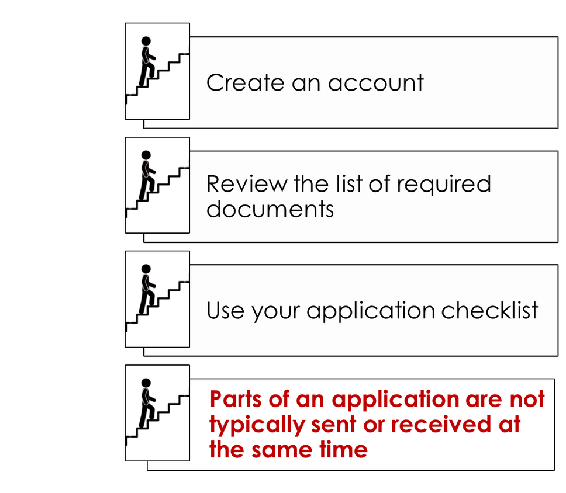
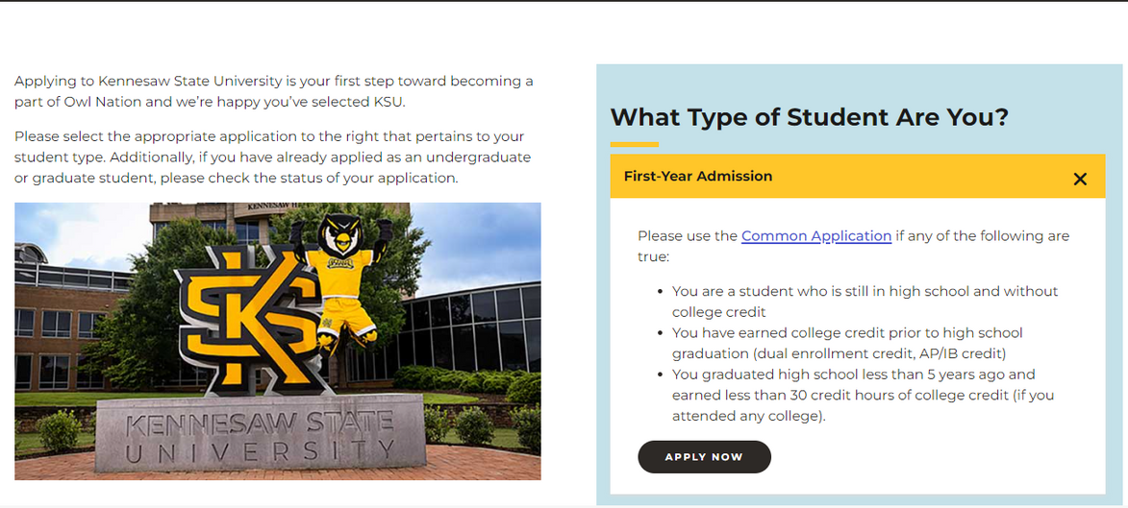

THE COLLEGE’S ADMISSION WEBPAGE
Notes:
Personal Data (address, citizenship, demographic info)
Education (schools you attended)
Test Info
Family History
Extracurricular Activities
Academic Honors
Work Experience
Essay/Personal Statement
Digital Signature

Slide 15

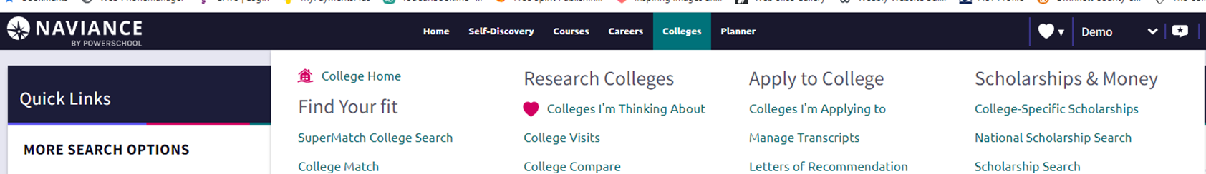


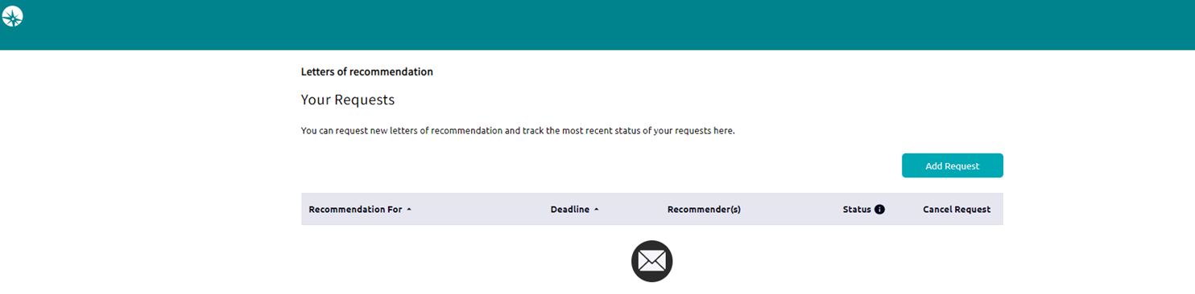


Requesting letters of recommendation from teachers

Slide 16
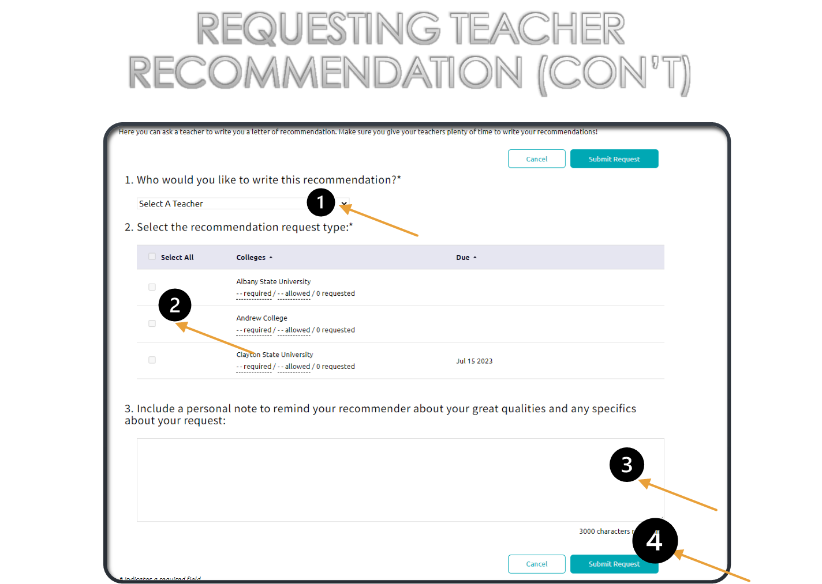

•Print out a hard copy to fill out as a rough draft
•Have all info you need on hand
•Save your work as you go
•Include Application Fee
•Check Spelling and Grammar
•SUBMIT!

Slide 17
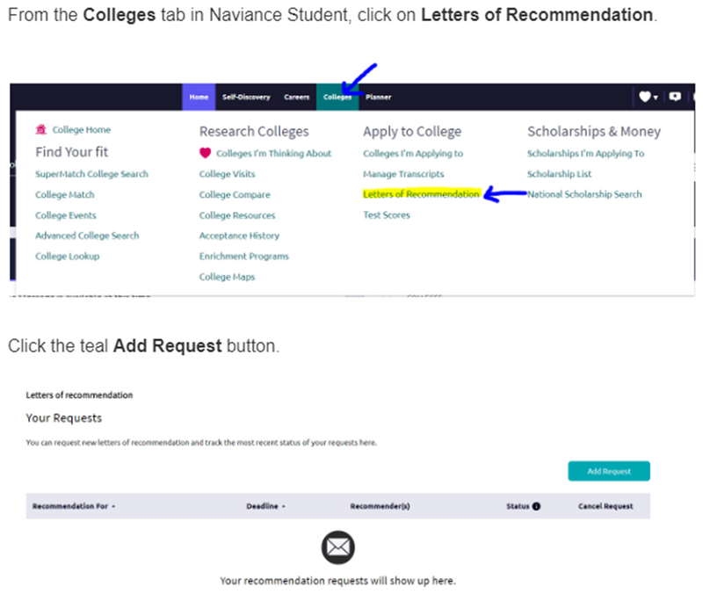
REQUESTING
LETTERS OF RECOMMENDATION
•You can submit it to your counselor and teachers electronically or bring a physical copy
•Keep copies of the brag sheet to give to your other recommenders
•Submit a Brag Sheet (found on the counseling website) at least 2 weeks before the deadline
Teachers, Coaches/Club Sponsors, Mentors, Administrators, etc. may serve as recommenders
•Ask the recommender for permission first
•Provide the recommender a copy of your brag sheet
•Provide a MINIMUM notice of 2 weeks
•Submit recommender’s name & e-mail into online application
•Only request a recommendation if the college requires it!
•Request (in person or by email) at least
2 weeks from the application deadline.
•Submit a BRAG Sheet to your counselor.
•Submit your request for TEACHER Recs through Naviance (see screenshot on right).
Notes:
If the college does not require a letter of recommendation, they will not accept or review any letters submitted.
*in house teacher only

Slide 18


REQUESTING TRANSCRIPTS
If you need an electronic copy for Naviance, counselors upload those for you on Naviance directly once you have paid for one on MyPaymentsPlus.
•Purchase it on MyPaymentsPlus ($5) or send to a GA college from GA Futures for FREE
•It is YOUR responsibility to follow up with the college to make sure the transcript was received
•If you need an electronic copy for Naviance, counselors upload those for you on Naviance directly once you have paid for one on MyPaymentsPlus.
If you need several physical copies, you would need to purchase each one at a cost of $5 each.
•Track the delivery of your transcript, through your college account, to ensure that it has been received by the recipient

Slide 19
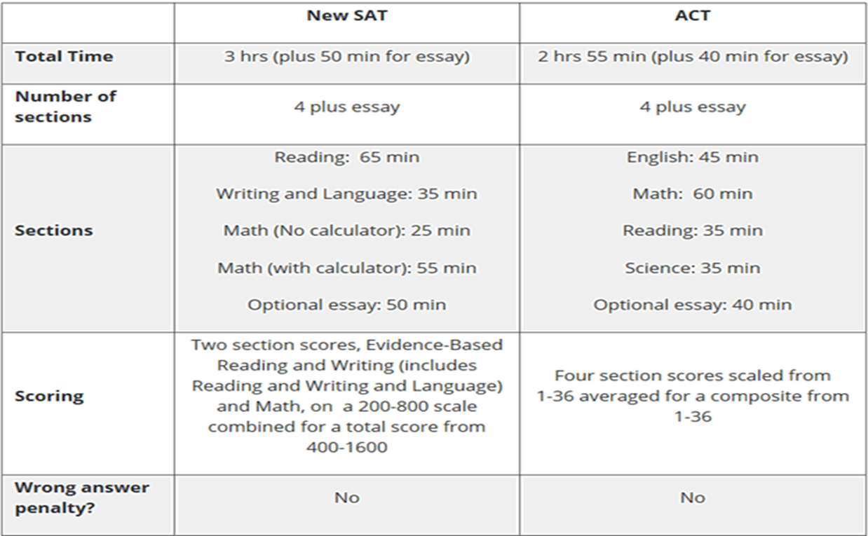


•SAT (www.collegeboard.org)
ACT (www.actstudent.org)
ACCUPLACER Test
•Placement test accepted at most 2 year colleges
•Colleges proctor this exam on their campuses
•Create your account
•Register for the test (select a date and location, upload a picture, and make the payment)
•Receive test scores
•Send scores to selected colleges (before and/or after exam)

Slide 20
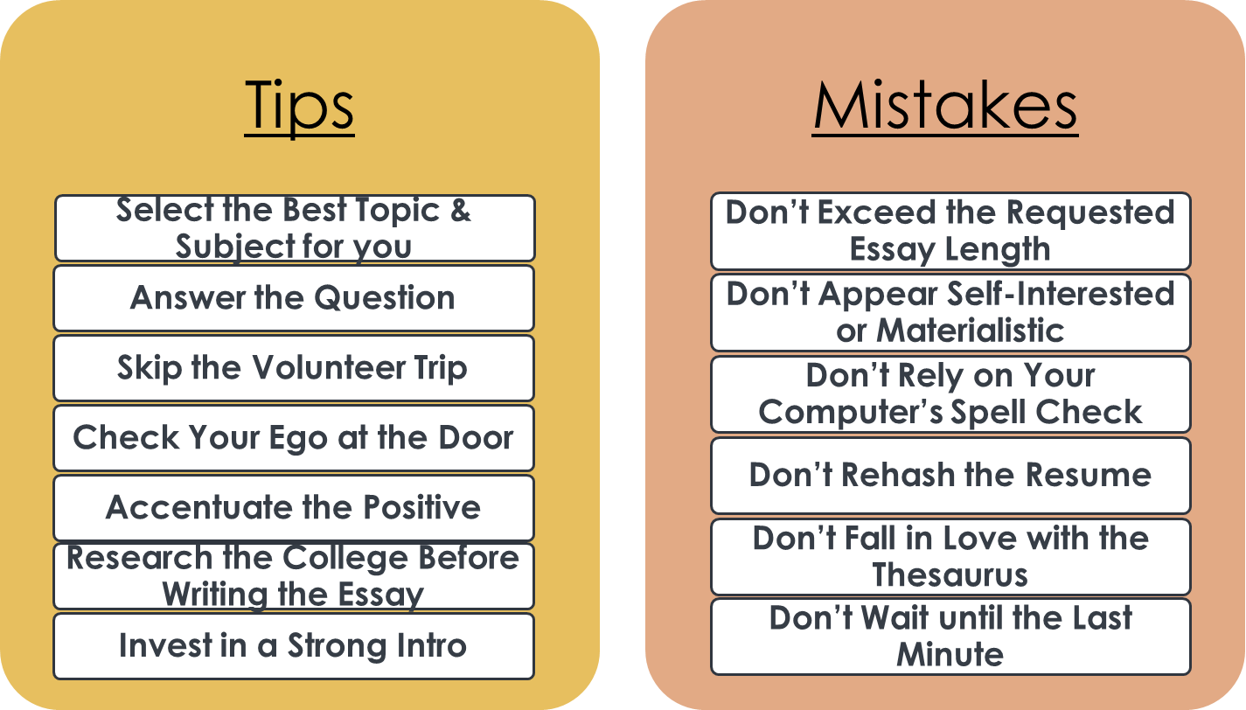

The College Application Essay

Slide 21
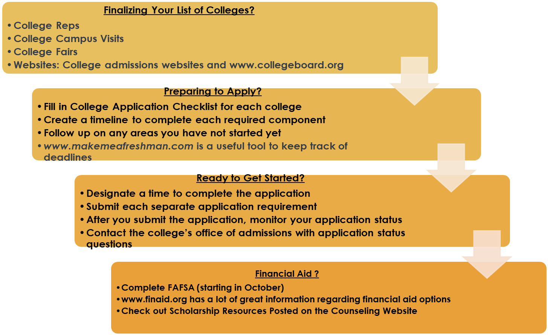

WHAT IS YOUR NEXT STEP…

Slide 22

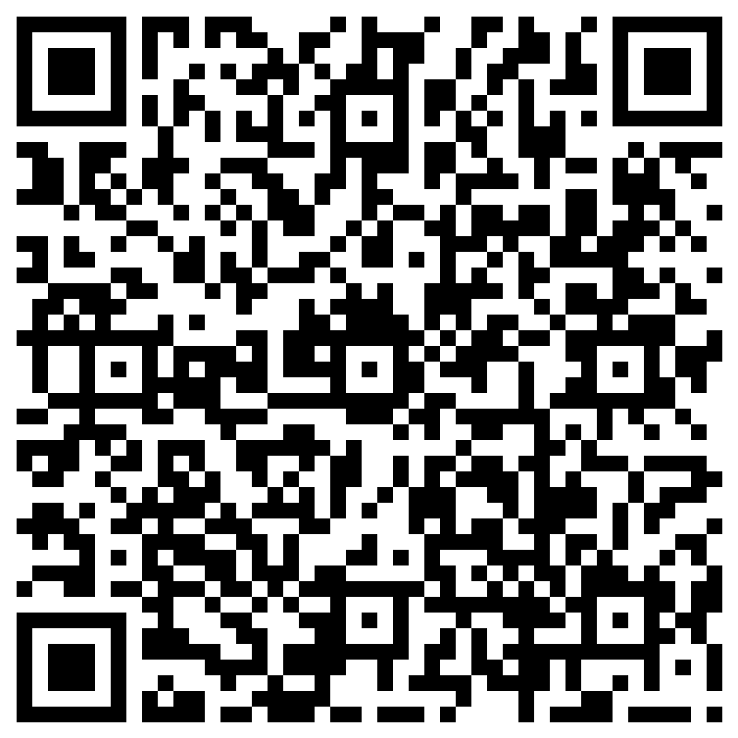
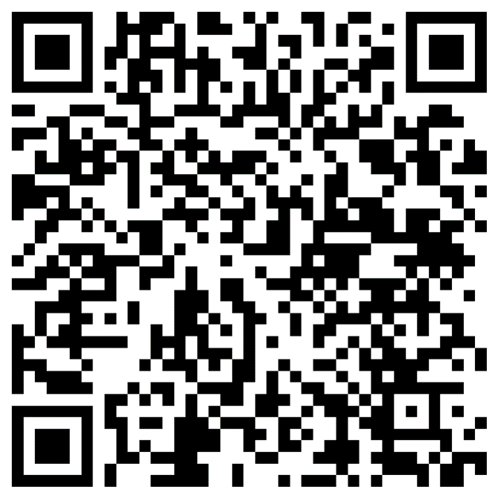
Post-Assessment
We are looking forward to a great year!

